Slide 1
NBM
Dan Trong Thai

Slide 2
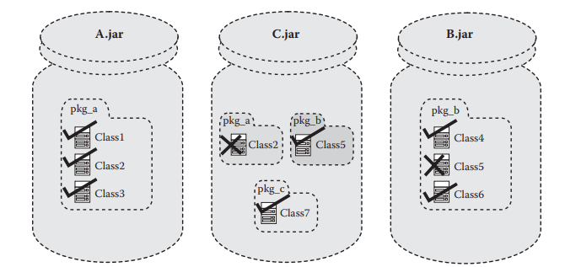
The Flat CLASSPATH Problem

Slide 3
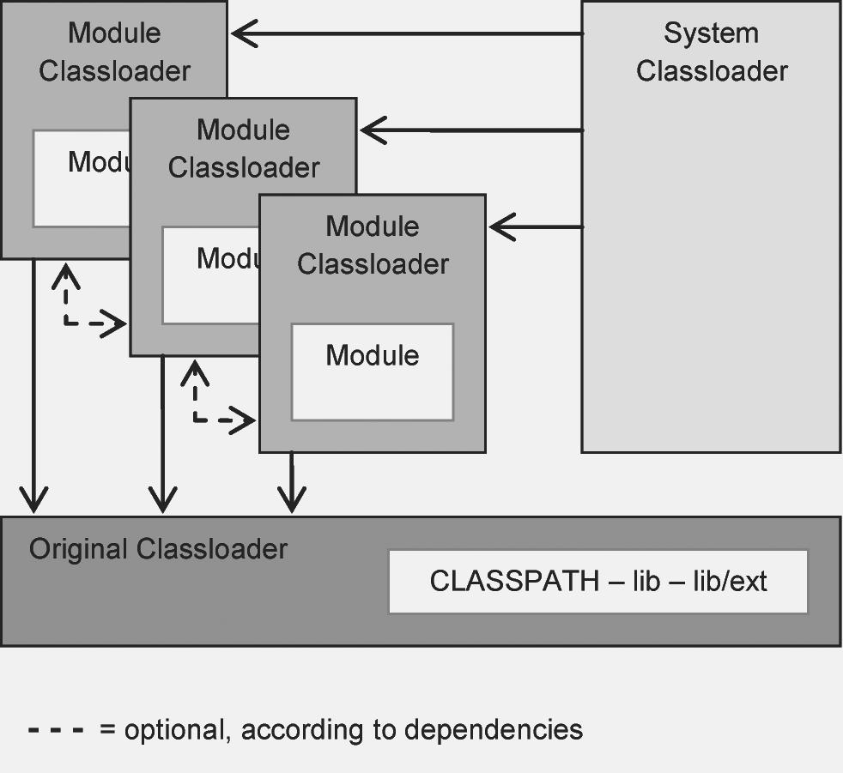
The Module Classloader

Slide 4
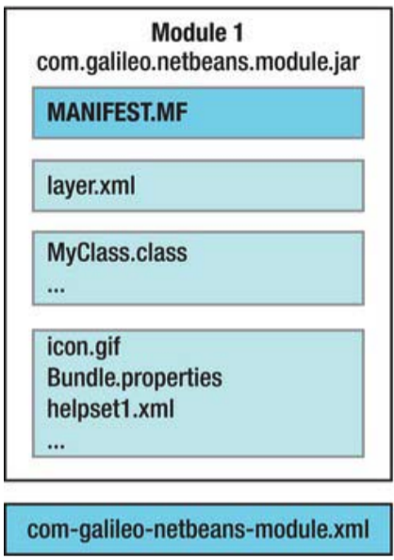
Modules in NetBeans
A module is a JAR archive which can consist of:
Manifest file
Layer file
Class files
Resource files
XML file

Slide 5
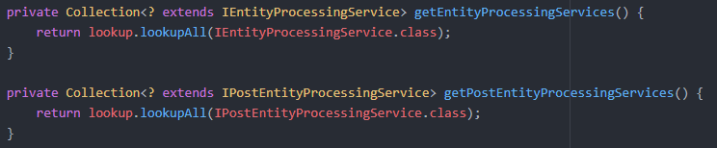
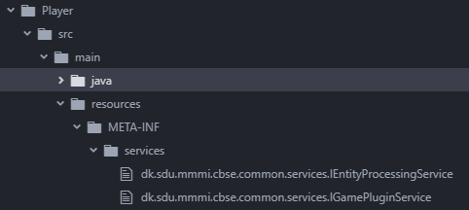

Netbeans Services
Whiteboard Model
Define services using META-INF files
Access services using Lookup API

